Slide 1
HDAG <> CAC
Final Presentation
Friday, December 15, 2023

Slide 2
Meeting Overview
Dimension 1
Module-specific insights on platforms, scores
Dimension 2
Cross analysis factors, survey feedback
Dimension 3/4
Locker experience, improvements
Notes:
Lillian

Slide 3
Dimension 1

Slide 4
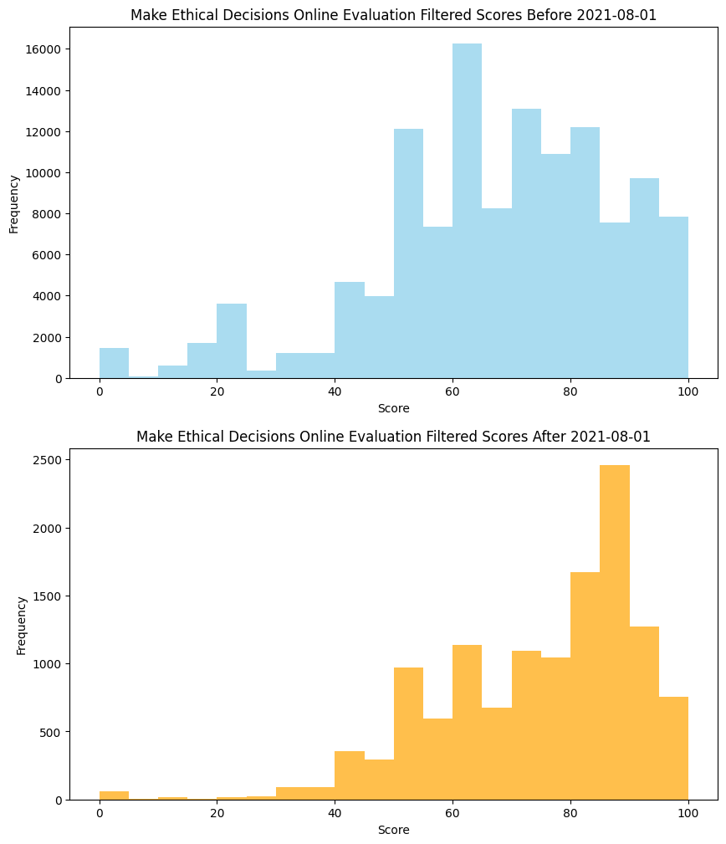
Make Ethical Decisions Online Evaluation: Score
After August 2021: Higher scores, distribution is is more left-skewed
Means: 66.74, 74.17
Standard deviations: 20.67, 17.11
Notes:
Joost

Slide 5
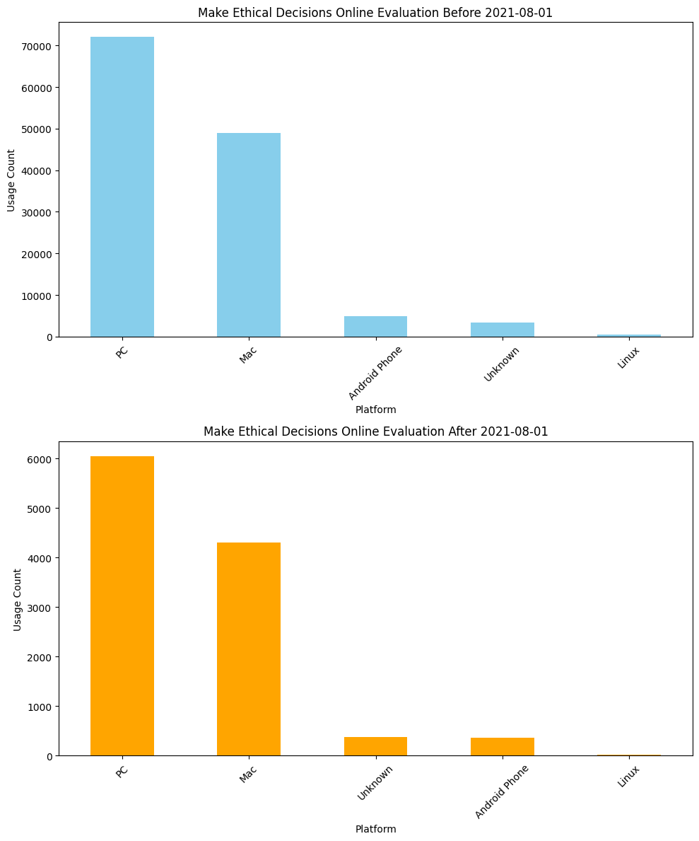
Make Ethical Decisions Online Evaluation: Platform
After August 2021: No noticeable change in platform usage
PC and Mac remain the top 2 platforms
Notes:
Joost

Slide 6
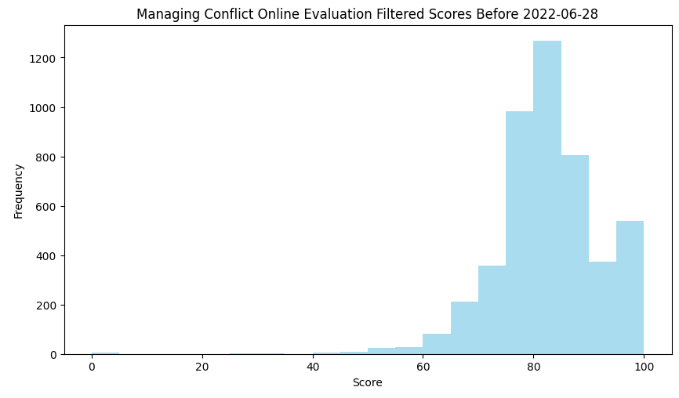
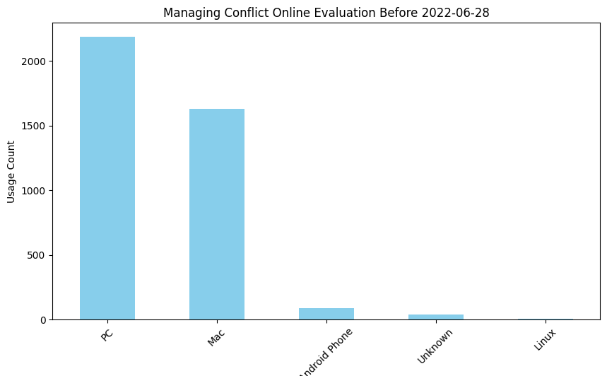
Managing Conflict Online Evaluation: Score and Platform
No data after June 28, 2022
Overall score distribution is right-learning
Mean: 82.11, standard deviation: 9.68
PC and Mac remain the top 2 platforms
Notes:
Joost, mention that there is no data after the date

Slide 7
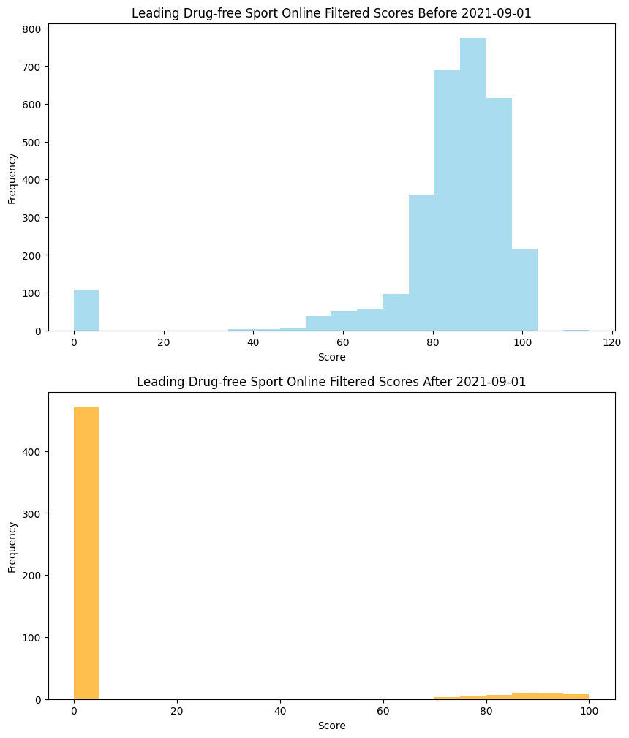
Leading Drug-free Sport Online Evaluation: Score
After September 2021: majority of scores are 0, with a few high scores
Highlights Effect of Changing Passing Score
Notes:
Aaron

Slide 8
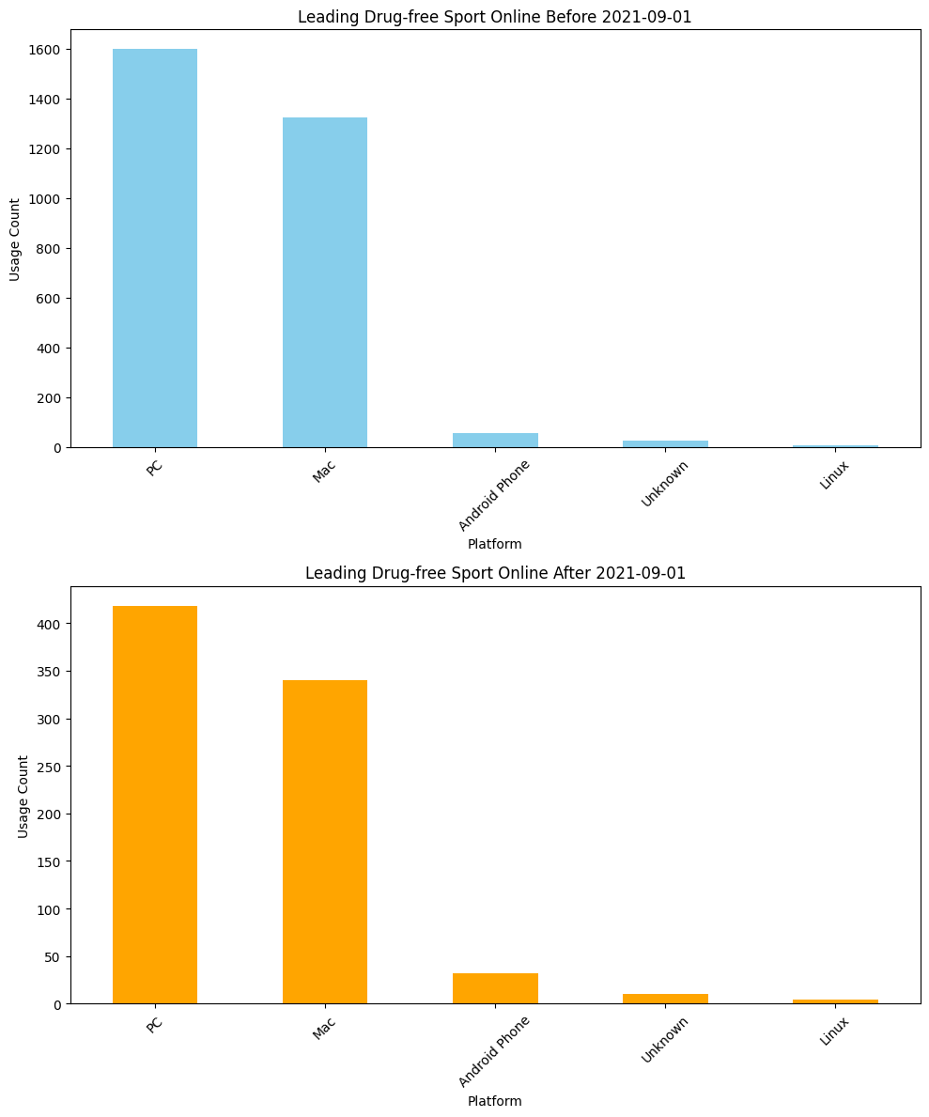
Leading Drug-free Sport Online Evaluation: Platform
After September 2021: Android Phone users increased in proportion
PC and Mac remain the top 2 platforms
Notes:
Aaron

Slide 9
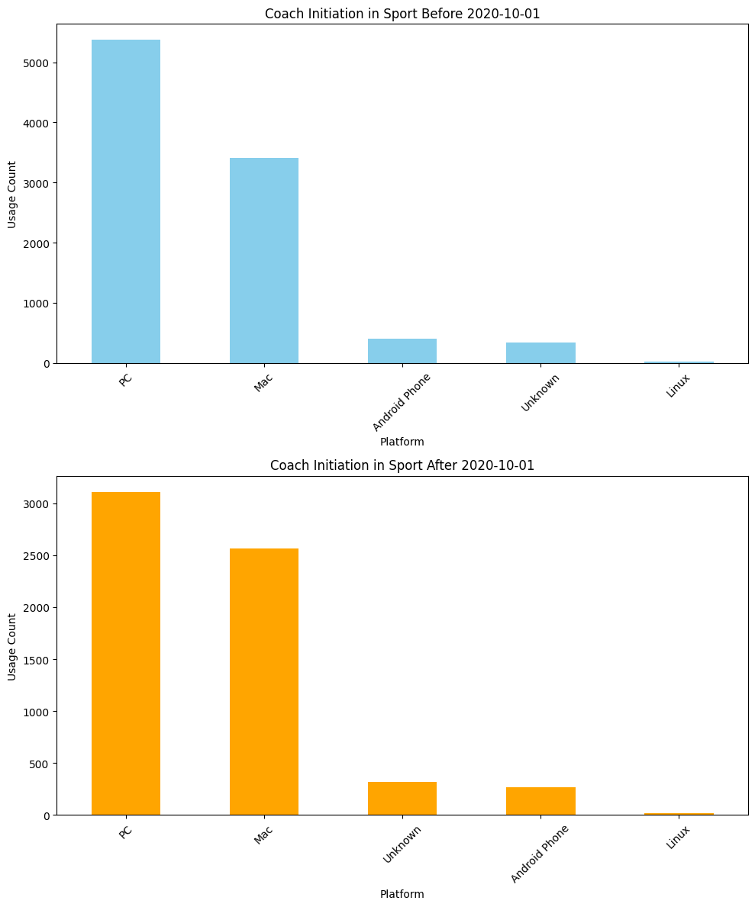
Coach Initiation in Sport: Platform
After October 2020: Proportion of Mac users increased
Android Phone and unknown users also increased slightly
Notes:
Aaron

Slide 10
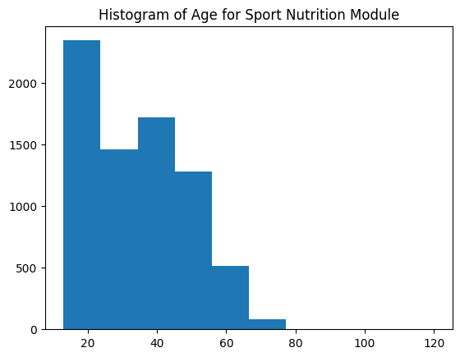
Sport Nutrition: Age
Participants in the Sport Nutrition Module tend to be on the younger side
Mean: 34.8
Bimodal distribution observed
Peaks at 15-25 and 35-44
Notes:
Zinn

Slide 11
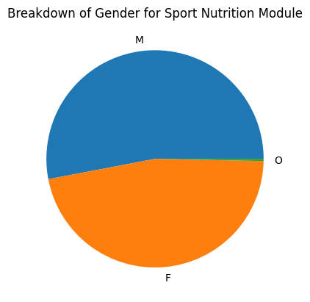
Sport Nutrition: Gender
Slight bias towards male participants
~53% Male, ~47% Female, ~0.3% Other
Notes:
Zinn

Slide 12
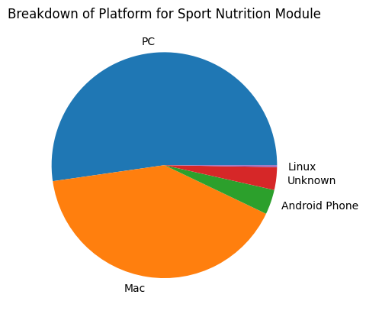
Sport Nutrition: Platform
Majority PC users, relatively small percentage of mobile users
~93% Desktop users (combined PC and Mac)
Notes:
Zinn

Slide 13
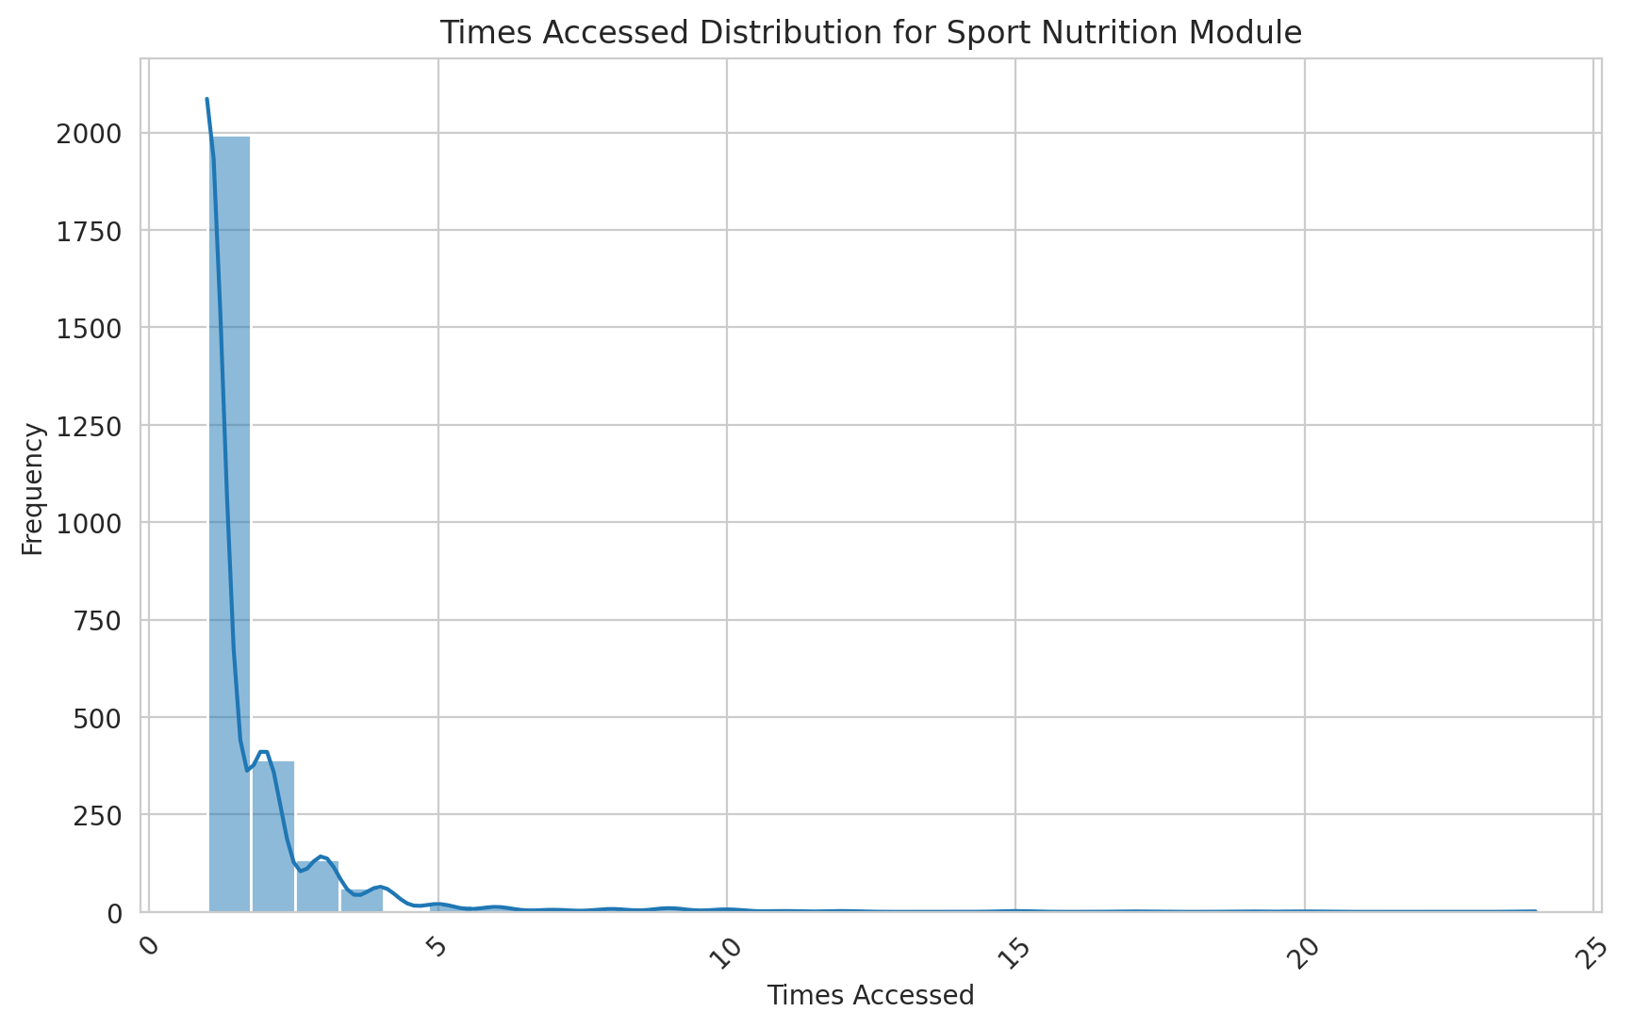
Sport Nutrition: Times Accessed
Most people only accessed the module once or twice
Notes:
Zinn

Slide 14
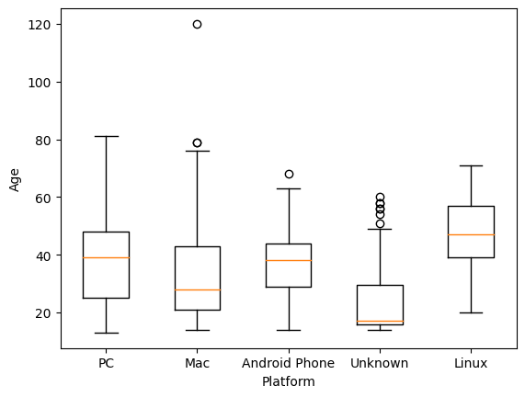
Sport Nutrition: Age vs Platform
Median age of Mac and “Unknown” users significantly lower than PC and Android users
Notes:
Zinn

Slide 15
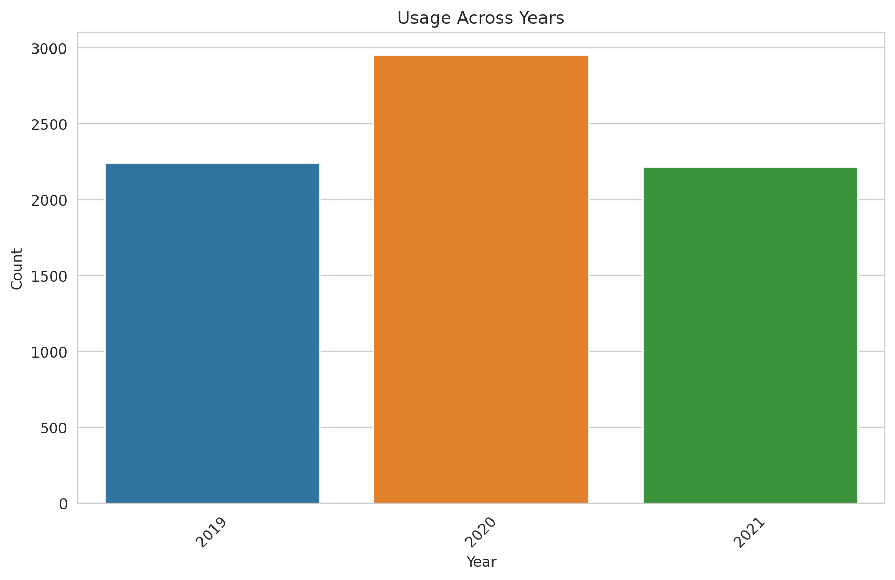
Sport Nutrition: Usage Across Years
Notes:
Zinn

Slide 16
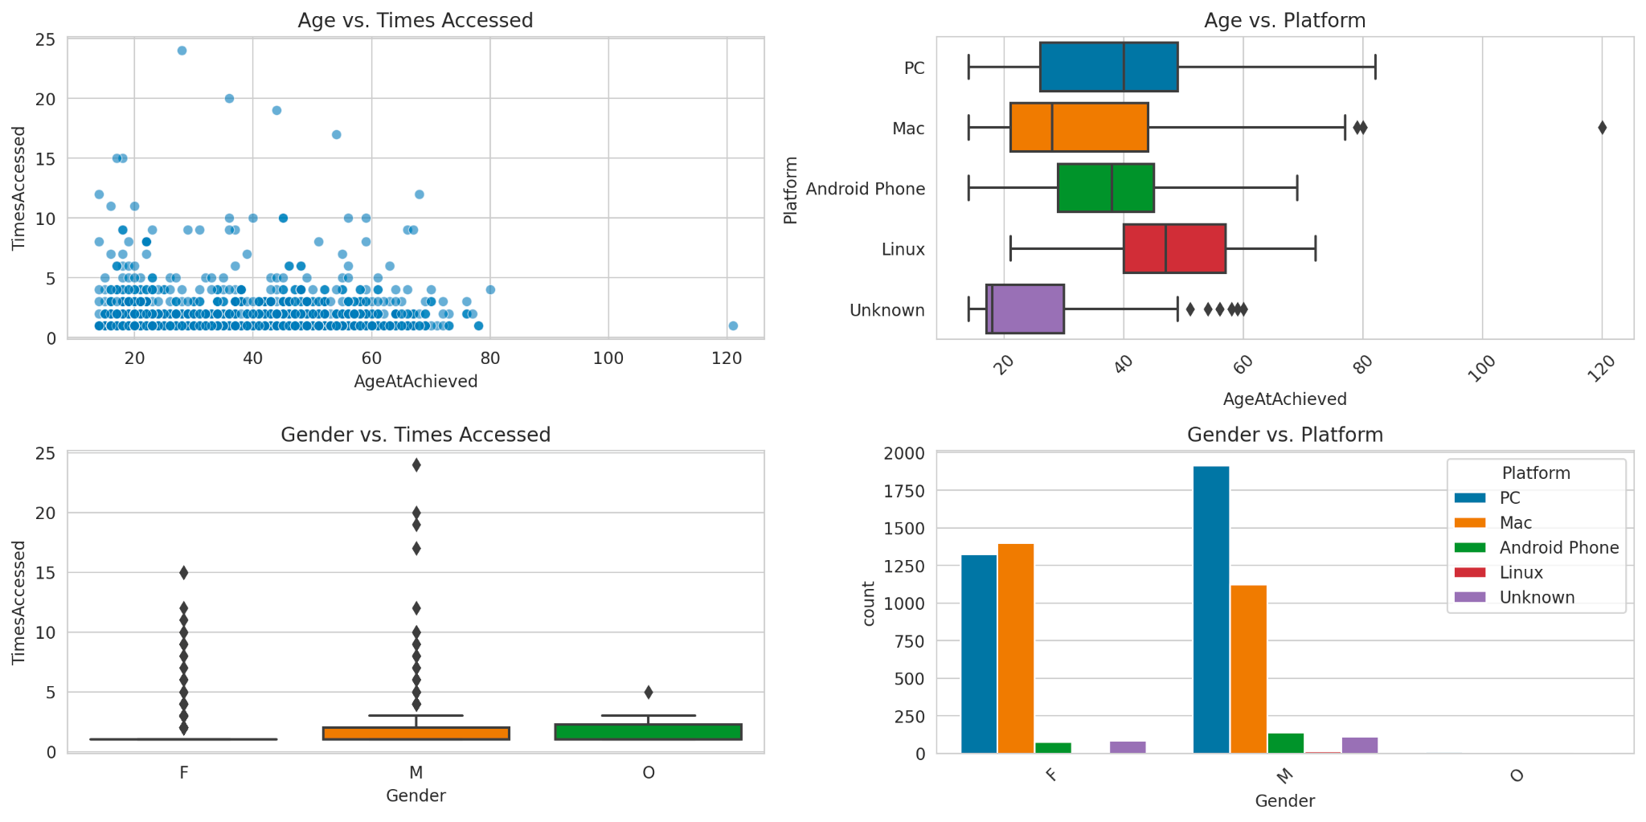
Sport Nutrition
Notes:
Zinn

Slide 17
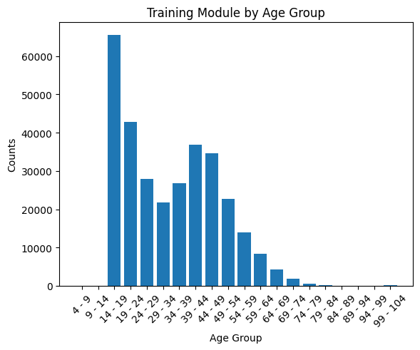
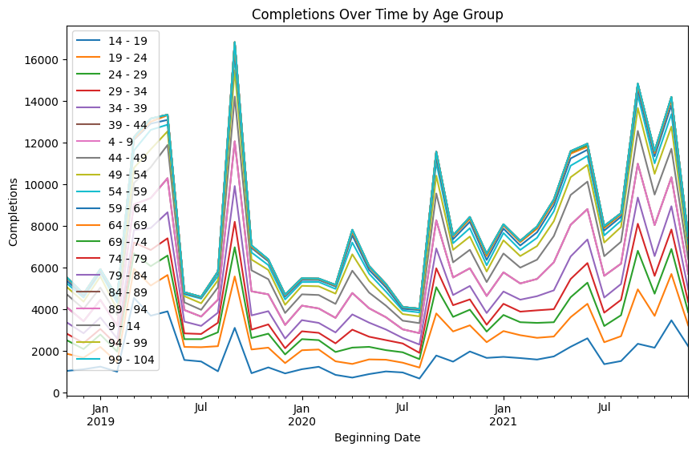
Training Modules
Notes:
Alan

Slide 18
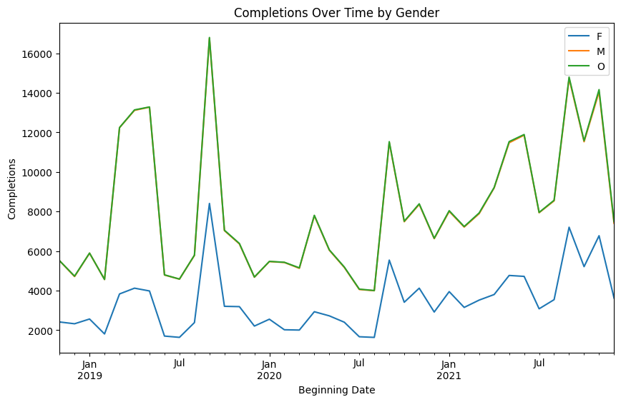
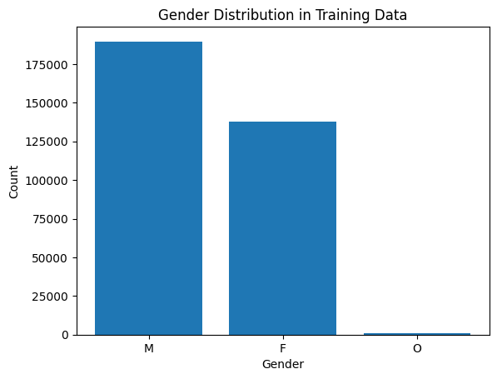
Training Modules
Notes:
Alan

Slide 19
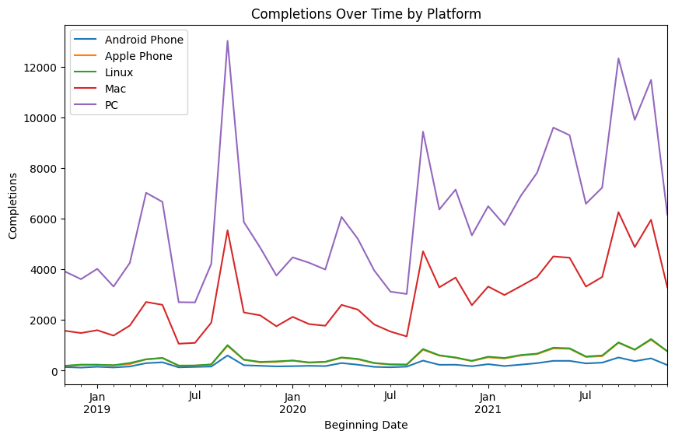
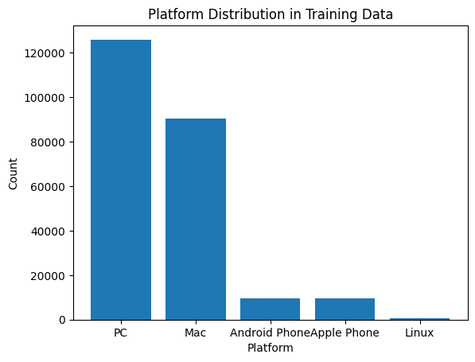
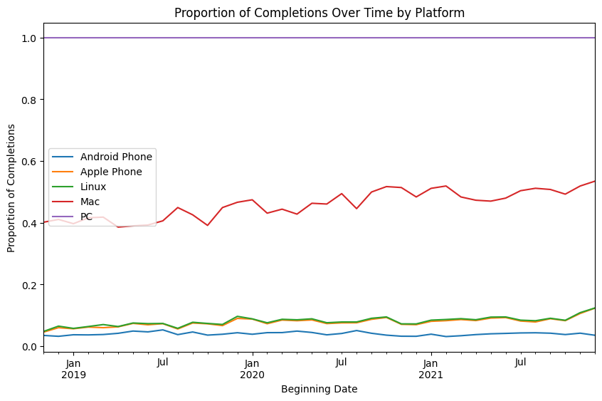
Training Modules
Notes:
Alan

Slide 20
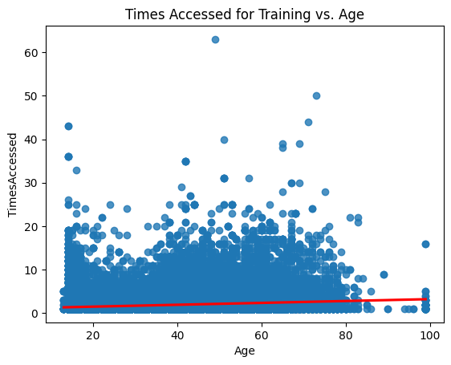
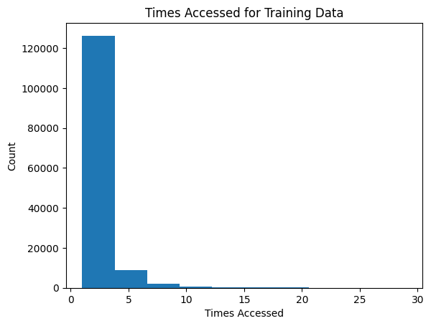
Training Modules
Notes:
Alan

Slide 21
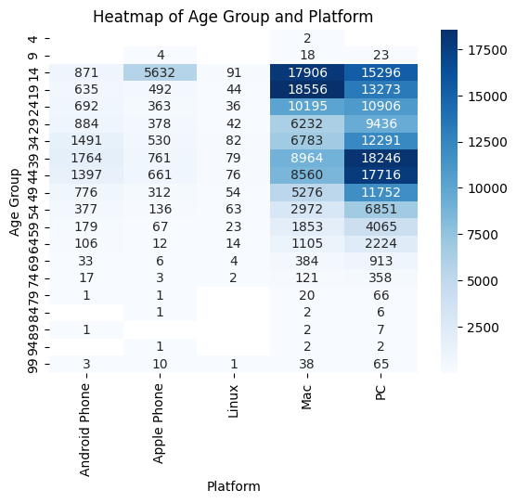
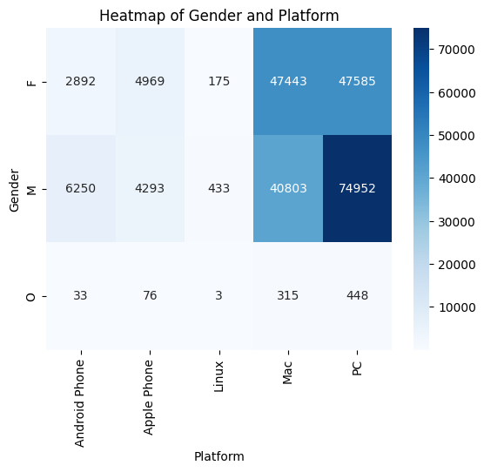
Training Modules
Notes:
Alan

Slide 22
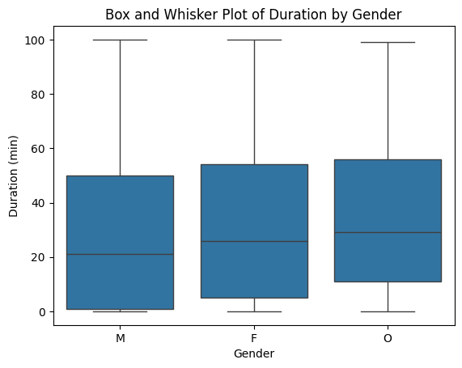
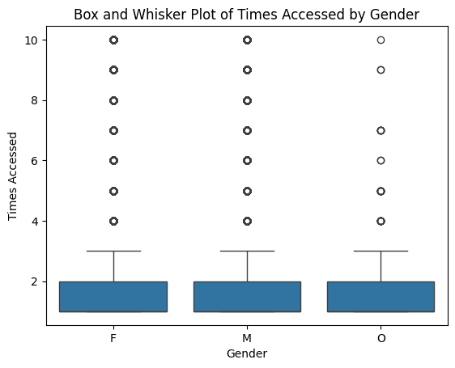
Training Modules
Notes:
Alan

Slide 23
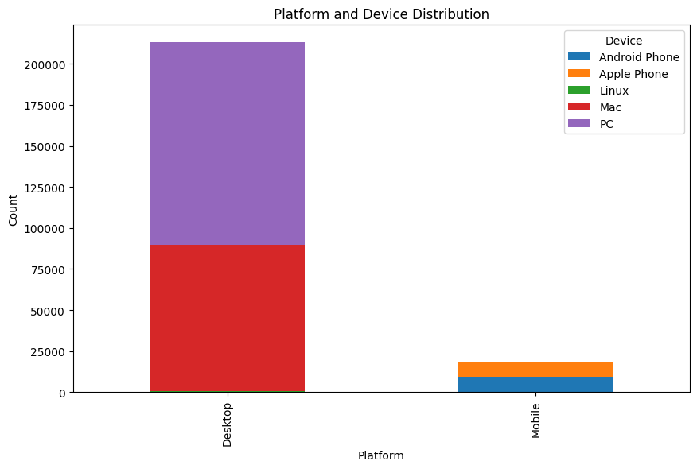
Training Modules
Notes:
Alan

Slide 24
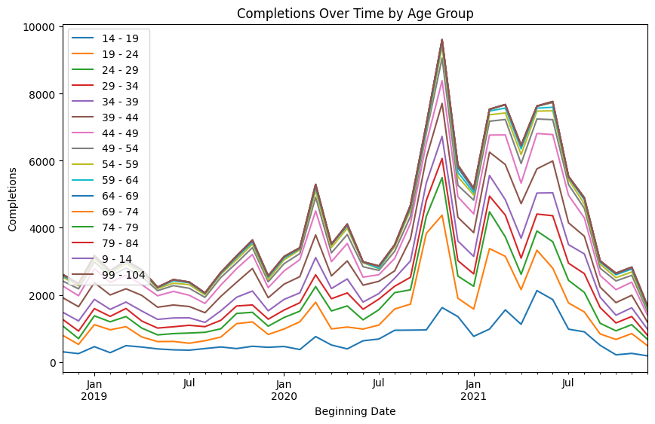
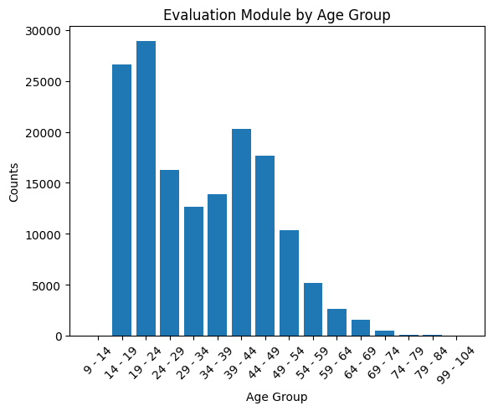
Evaluation Modules
Notes:
Alan

Slide 25
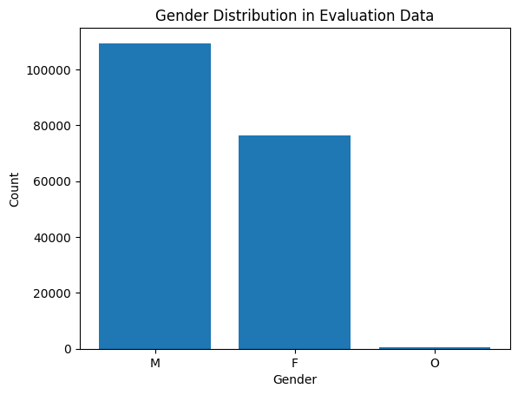
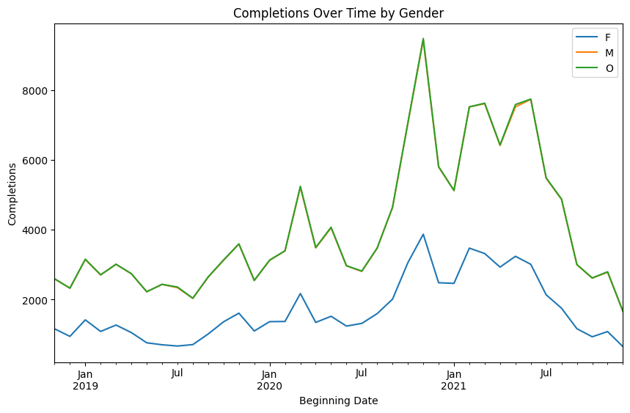
Evaluation Modules
Notes:
Alan

Slide 26
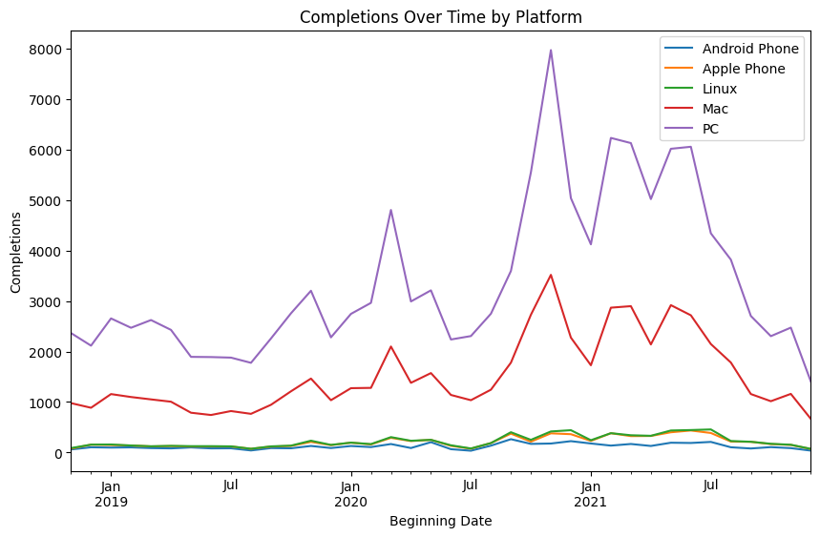
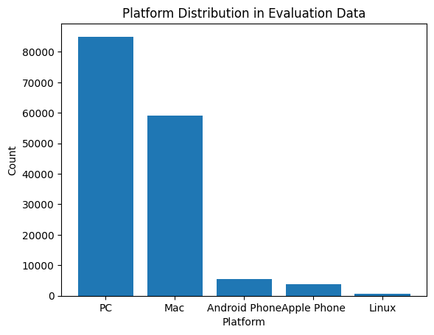
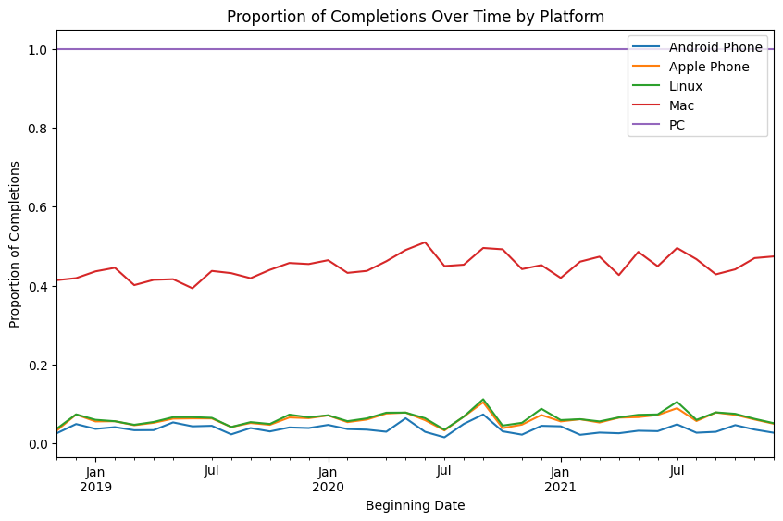
Evaluation Modules
Notes:
Alan

Slide 27
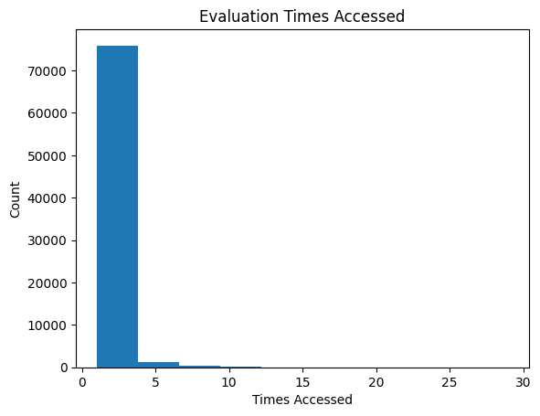
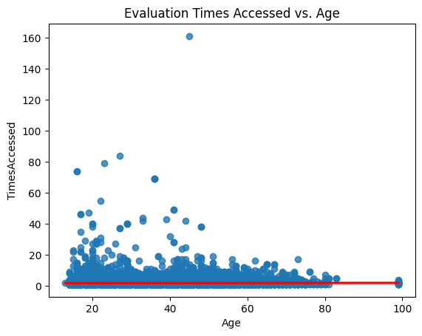
Evaluation Modules
Notes:
Alan

Slide 28
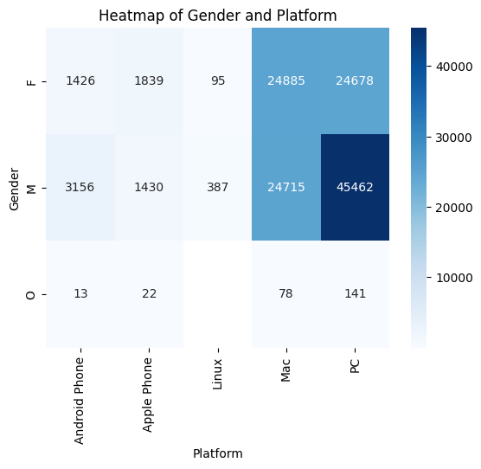
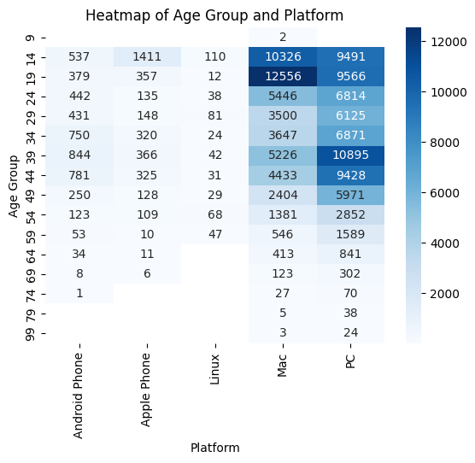
Evaluation Modules
Notes:
Alan

Slide 29
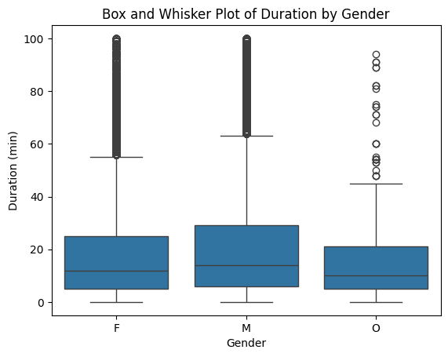
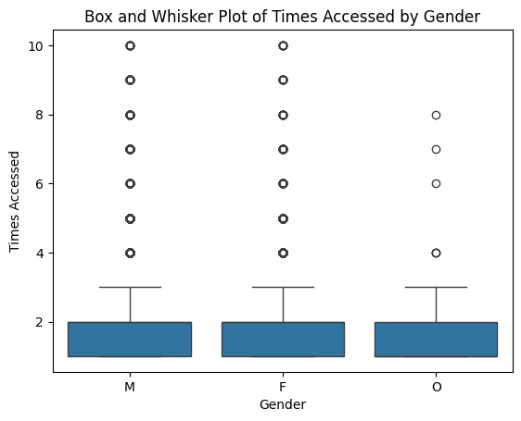
Evaluation Modules
Notes:
Alan

Slide 30

Evaluation Modules
Notes:
Alan

Slide 31
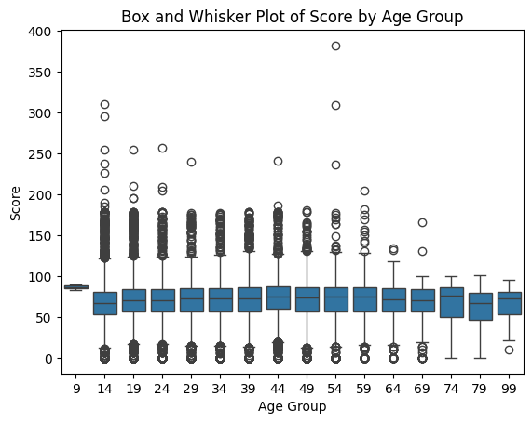
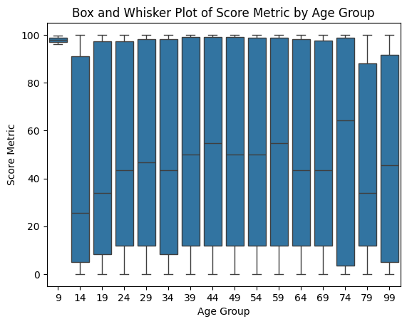
Evaluation Modules
Notes:
Alan

Slide 32
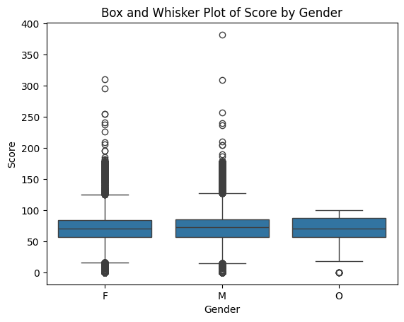
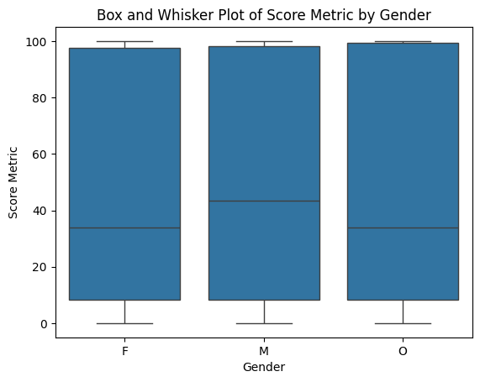
Evaluation Modules
Notes:
Alan

Slide 33
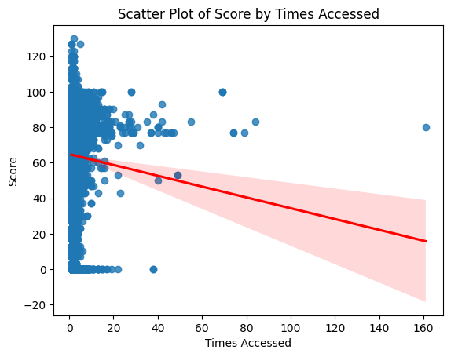
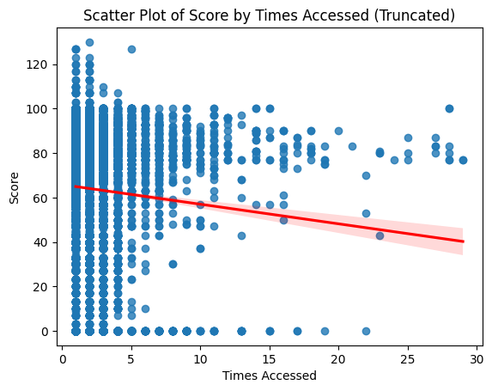
Evaluation Modules
Notes:
Alan

Slide 34
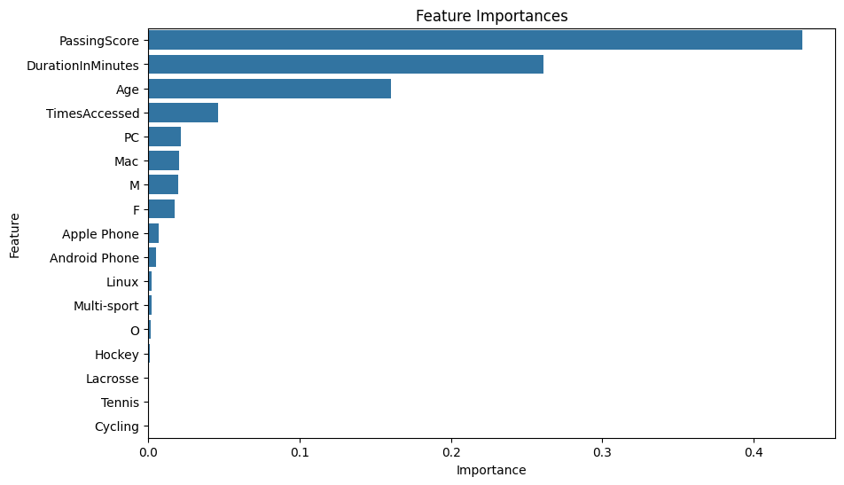
Evaluation Modules: Important Factors influencing Score
Passing Score influences the final score that users have the most
Also important is how frequently they access and how long the duration is (relationship is not necessarily linear)
Age is also very important in predicting score
Desktop vs mobile is less important
Notes:
Alan

Slide 35
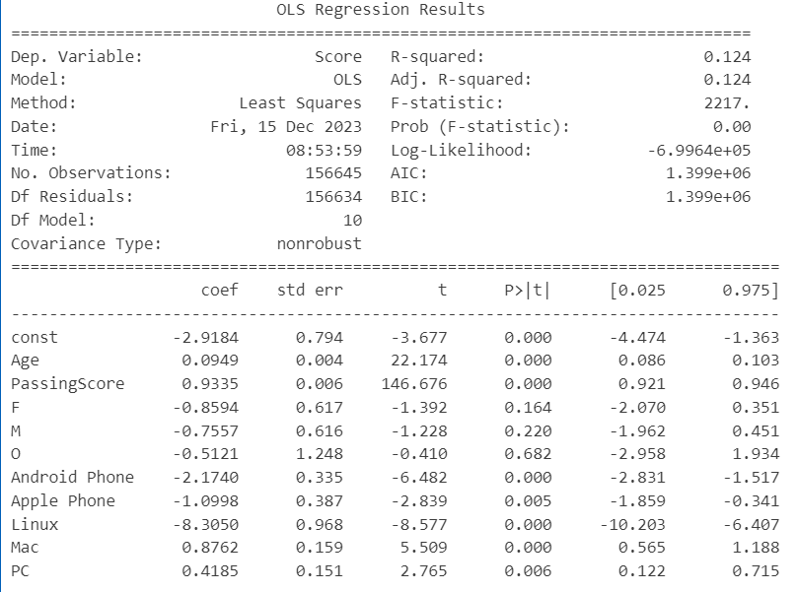
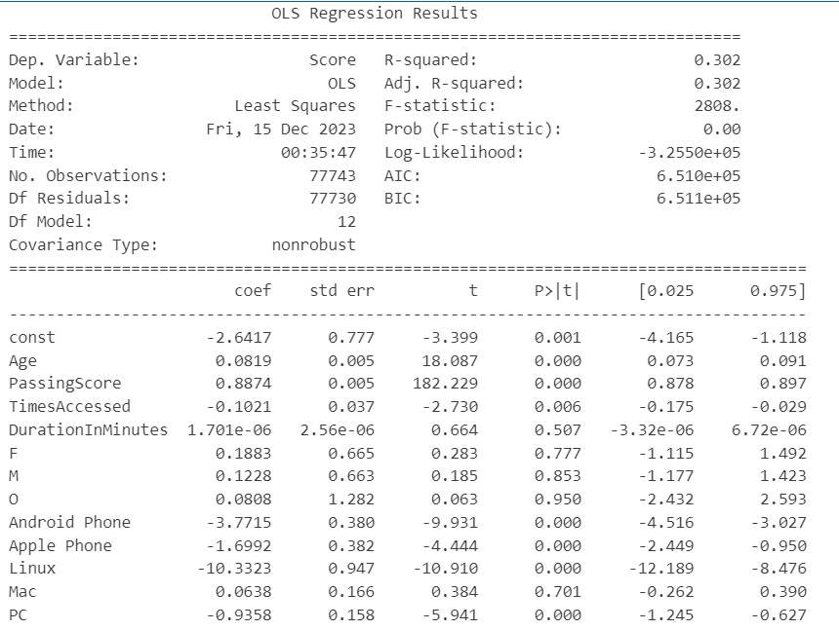
Evaluation Modules: Specific Factor Effects
Conditions satisfied
Mobile usage correlates with a strong decrease in score
Strong increasing effect of passing score
Effect of Gender is insignificant relative to other factors
Duration in Minutes effect is likely nonlinear
Based on difference between decision tree and OLS
Notes:
Alan

Slide 36


Slide 37
Takeaways
Take care in setting passing score: high degree of influence on level of interaction with module
Coefficient of passing score is nearly 1
Current version of mobile website is important factor to consider in lower scores in mobile users
Duration and times accessed is not a great predictor of engagement, lots of noise at different levels
Age and gender effects are less visible given other predictors
Very short survey at completion of each module would likely serve as better predictor of engagement
Notes:
Alan

Slide 38
Dimension 2

Slide 39
Cross-Analysis Factors
Socioeconomic Status of Athletes and Coaches
Socioeconomic factors can impact access to coaching and resources
Highlights disparities in access and need for varied pricing models
Age Group of Athletes Being Coached
Help tailor coaching methods and content to be age-appropriate and effective
Gender of Coaches and Athletes
Gender dynamics can influence coaching styles, communication, and overall coaching environment
Understanding of gender balance and the need for gender-specific coaching approaches or training
Scores of Certain Topics/Modules
What topics have lower scores can indicate additional coaching or training is necessary
Notes:
Emily

Slide 40


Final Survey Draft
Branching: works as expected
Example: Do you identify as a member of the 2SLGBTQIA+ community?
Accurate branching: Selecting no skips the question asking for specific information
Languages in India
Greater number of languages (unlike clear Mandarin and Cantonese majority in China)
Recommend adding a new category to group all of them, but mention them by name
Branching follow up question for specific language
Notes:
Lillian

Slide 41

Final Survey Draft
Please identify any areas where you feel we are missing an opportunity to collect relevant data (all included in Locker)
Sport of coach/participant
Gender
Residence within Canada
Include short free-response questions at end of survey:
Survey takes only a few minutes, including 1 or 2 short free-response questions at end for more information if participant wants to elaborate further on previous multiple-choice questions
Notes:
Lillian

Slide 42
Dimension 3/4

Slide 43
Mobile Locker Design vs Industry Norms
Password change should confirm old password first
If old password is forgotten, use email or SMS verification
2FA with phone number or authentication app
Log-in with email doesn’t seem to work even though email is connected to NCCP #
Data privacy
Anonymization of data
Data should not be linked together but scrambled
Transparency on data collection and use
Homepage dashboard with icon links to other pages of Mobile Locker
Homepage loading also takes a while
Notes:
Emily

Slide 44
Web-Wrapping App
Natively
Free preview feature, $32/month for iOS + Android App support
iOS
React Native, Flutter or Xamarin
Free/open-source
Will need technical maintenance
Android
Webview
Free/open-source
Will need technical maintenance
Notes:
Emily

Slide 45

First-Time Users (Desktop)
On the desktop homepage, the e-learning page is not immediately obvious
Recommendations:
Streamline navigation by reorganizing the desktop homepage to include a link to e-learning
Notes:
Eileen

Slide 46

First-Time Users (Desktop)
On the e-learning page, instructions to get started are clear and direct
Notes:
Eileen

Slide 47


User Experience Walk Through - Home Page
In mobile view, it is difficult to navigate to different pages
Recommendations:
Remove the top navigation bar and only use the hamburger menu when the window is small
Increase the button sizes and responsiveness (specifically search and hamburger menu)
Notes:
Eileen

Slide 48



User Experience Walk Through - Modules
The home page takes a while to load
There is no way to explore or purchase e-learning modules or register for events through the mobile version.
A new user will see, “You have completed all available eLearning modules!”
Include more concept checks to make the materials more engaging
Incorporate more feedback when someone gets an answer wrong to make quizzes more responsive, instead of just changing the colour of the bubble
Notes:
Eileen

Slide 49



User Experience Walk Through - Account
Password changes should be protected by the old password.
When using different browsers and devices, width is fixed so text is cut off (ex. Firefox on Android)
Notes:
Eileen

Slide 50

Recommendations for New Locker Users
Create interactive guides and walkthroughs for the website to showcase features!
UserGuiding is a comprehensive user onboarding and guidance platform with a simple drag-and-drop editor and customizable templates.
WalkMe is a digital adoption platform that offers a range of features, including real-time guidance.
Hopscotch is an open-source framework.
Joyride is a lightweight, open-source library.
Notes:
Eileen

Slide 51

Recommendations For Overall Better Journey
Allow coaches to set their own goals and provide recommendations on how to meet them
Ex. completion of one module recommends one on a related topic
Game-ify modules to encourage completion
Ex. monthly leaderboard for highest points or number of modules completed wins free gear
Foster a community and network across coaches using the platform
Online discussion board or forum; ex. Slack
Notes:
Emily

Slide 52
Target Audience
We can define Target Audience as: coaches for any sport at a school, extracurricular club or community teams
Partnerships with schools/organizations to provide Locker and module access
College sports teams
Encourage attendance of events
In-person training or gatherings
Hosting panels at sports conventions
Create and share content that is relevant through social media
Coaching newsletter with tips, training techniques, nutrition advice, new sports technology etc.
Blogs, podcasts, videos, and webinars can also be effective
Spotlight a coach every week/month
Notes:
Emily

